Slide 1

Department of Computer Science and Engineering
Course name : Data Science
Course code : U23AD491
Title of the project :
Multi-Factor Investment Intelligence Platform

Slide 2
Class / Section / Semester | : | III CSE / A / V
Batch | : | 2024-2028
Project Review | : | First Review
Date | : | 13.07.2026
Faculty I/C | : | Dr. M. Suriya, M.E., Ph.D., AP/CSE
Title | : | Multi-Factor Investment Intelligence Platform
Student Name & Reg No | : | Dhanushya T[722824104052]

Slide 3
Abstract
Develops a data-driven investment decision support system.
Collects data from stock prices, financial statements, technical indicators, market sentiment, and economic factors.
Performs data cleaning, preprocessing, and feature engineering to prepare high-quality data.
Applies Machine Learning to generate an Investment Score and classify stocks as Buy, Hold, or Sell.
Integrates Explainable AI (XAI) to provide transparent reasons behind every recommendation.
Offers an interactive dashboard for company comparison, portfolio analysis, and market insights.
Helps investors make accurate, data-driven, and informed investment decisions.
Reduces investment uncertainty by combining multiple analytical factors into a single intelligent platform.

Slide 4
CONCEPT & SCOPE OF SOLUTION
Concept | Scope of Solution
AI-powered investment decision support system | Collect multi-source financial and market data
Multi-factor stock evaluation | Perform data preprocessing and feature engineering
Machine Learning-based investment analysis | Generate Investment Score and Buy/Hold/Sell recommendation
Explainable AI for transparent decisions | Provide reason-based investment insights
Data-driven investment intelligence | Compare companies and analyze portfolio risk
Interactive analytics platform | Visualize trends through an intelligent dashboard

Slide 5
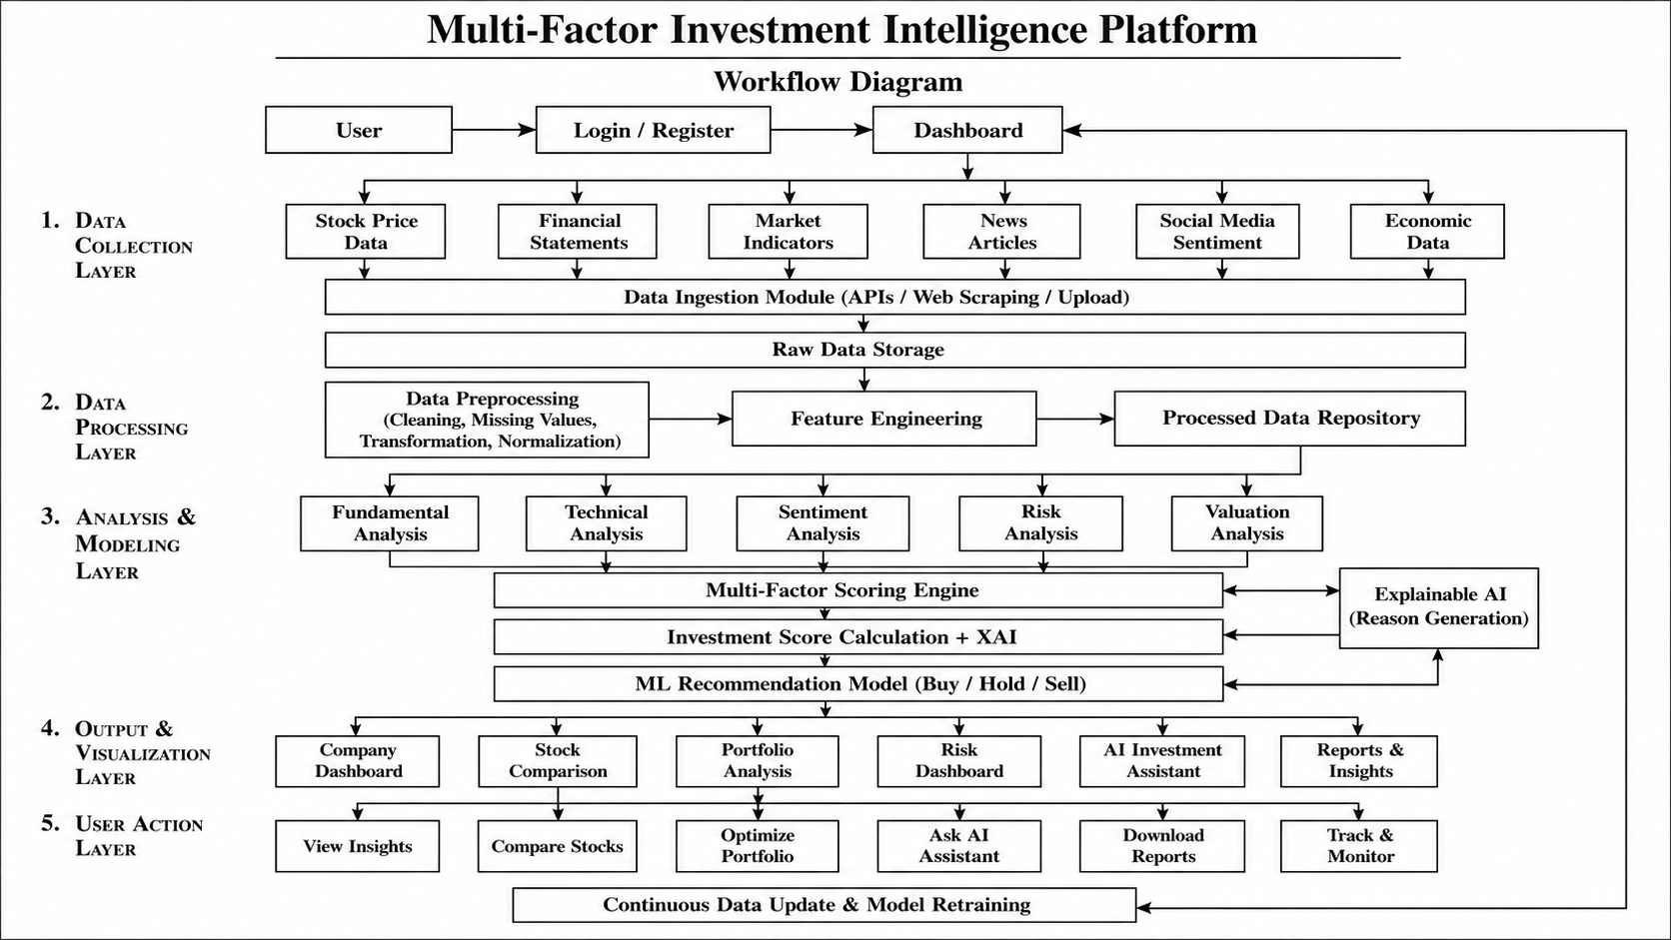
PROPOSED METHOD
Work flow diagram

Slide 6
TECHNOLOGY USED
Category | Technology
Programming Language | Python
Frontend | React.js, Tailwind CSS
Backend | FastAPI
Database | PostgreSQL
Data Collection | yfinance, Alpha Vantage, NewsAPI
Data Processing | Pandas, NumPy
Machine Learning | Scikit-learn, XGBoost
Explainable AI | SHAP
Visualization | Plotly, Matplotlib
Development Tools | Git, GitHub, VS Code

Slide 7
PROJECT MODULES
Module | Function
Data Collection | Gather financial & market data
Data Processing | Clean & prepare data
Multi-Factor Analysis | Analyze investment factors
Machine Learning | Generate investment recommendations
Explainable AI | Explain predictions
Dashboard | Visualize insights & reports

Slide 8
CONCLUSION
The Multi-Factor Investment Intelligence Platform provides a comprehensive and data-driven approach to investment analysis by integrating financial, technical, sentiment, and risk factors into a single intelligent system. By leveraging Machine Learning and Explainable AI, the platform delivers transparent investment recommendations and interactive visual insights. This solution enables investors to make informed decisions with greater confidence while demonstrating the practical application of data science and artificial intelligence in the financial domain.

